Slide 1


Real Estate
Ali Reda & Hadi Srour

Slide 2
Table Of Contents
1
2
3
Research
Problem
Data Set
Exploratory
Analysis
4
5
ML algorithms
Conclusion

Slide 3
Introduction
# Real-State-Price-Prediction
In this project we want to predict prices based on some feature.
I have used machine learning regression models to predict the prices Data cleaning and exploration is performed at initial stages.
visualization techniques are use for better understanding of data.
At the end best regression model is chosen out of Linear Regression , Decision Tree , Random Forest and KNN base on the performance of the models.

Slide 4
About the Dataset
SIZE
500 INSTANCES FROM KAGGLE 14.0 KB
PREDICTERS
TARGET
13 FEATURES
MEDV
(Median Value of Owner-Occupied Homes)

Slide 5

CRIM per capita crime rate by town
RM average number of rooms per dwelling
AGE proportion of owner-occupied
units built prior to 1940
ZN proportion of residential land
zoned for lots over 25,000 sq.ft.
LSTAT % lower status of the population
INDUS proportion of
non-retail business acres per town
RAD index of accessibility to radial highways
CHAS Charles River dummy variable
(= 1 if tract bounds river; 0 otherwise)
TAX full-value property-tax rate per $10,000
MEDV Median value of owner-occupied homes in $1000's
NOX nitric oxides concentration (parts per 10 million)

Slide 6
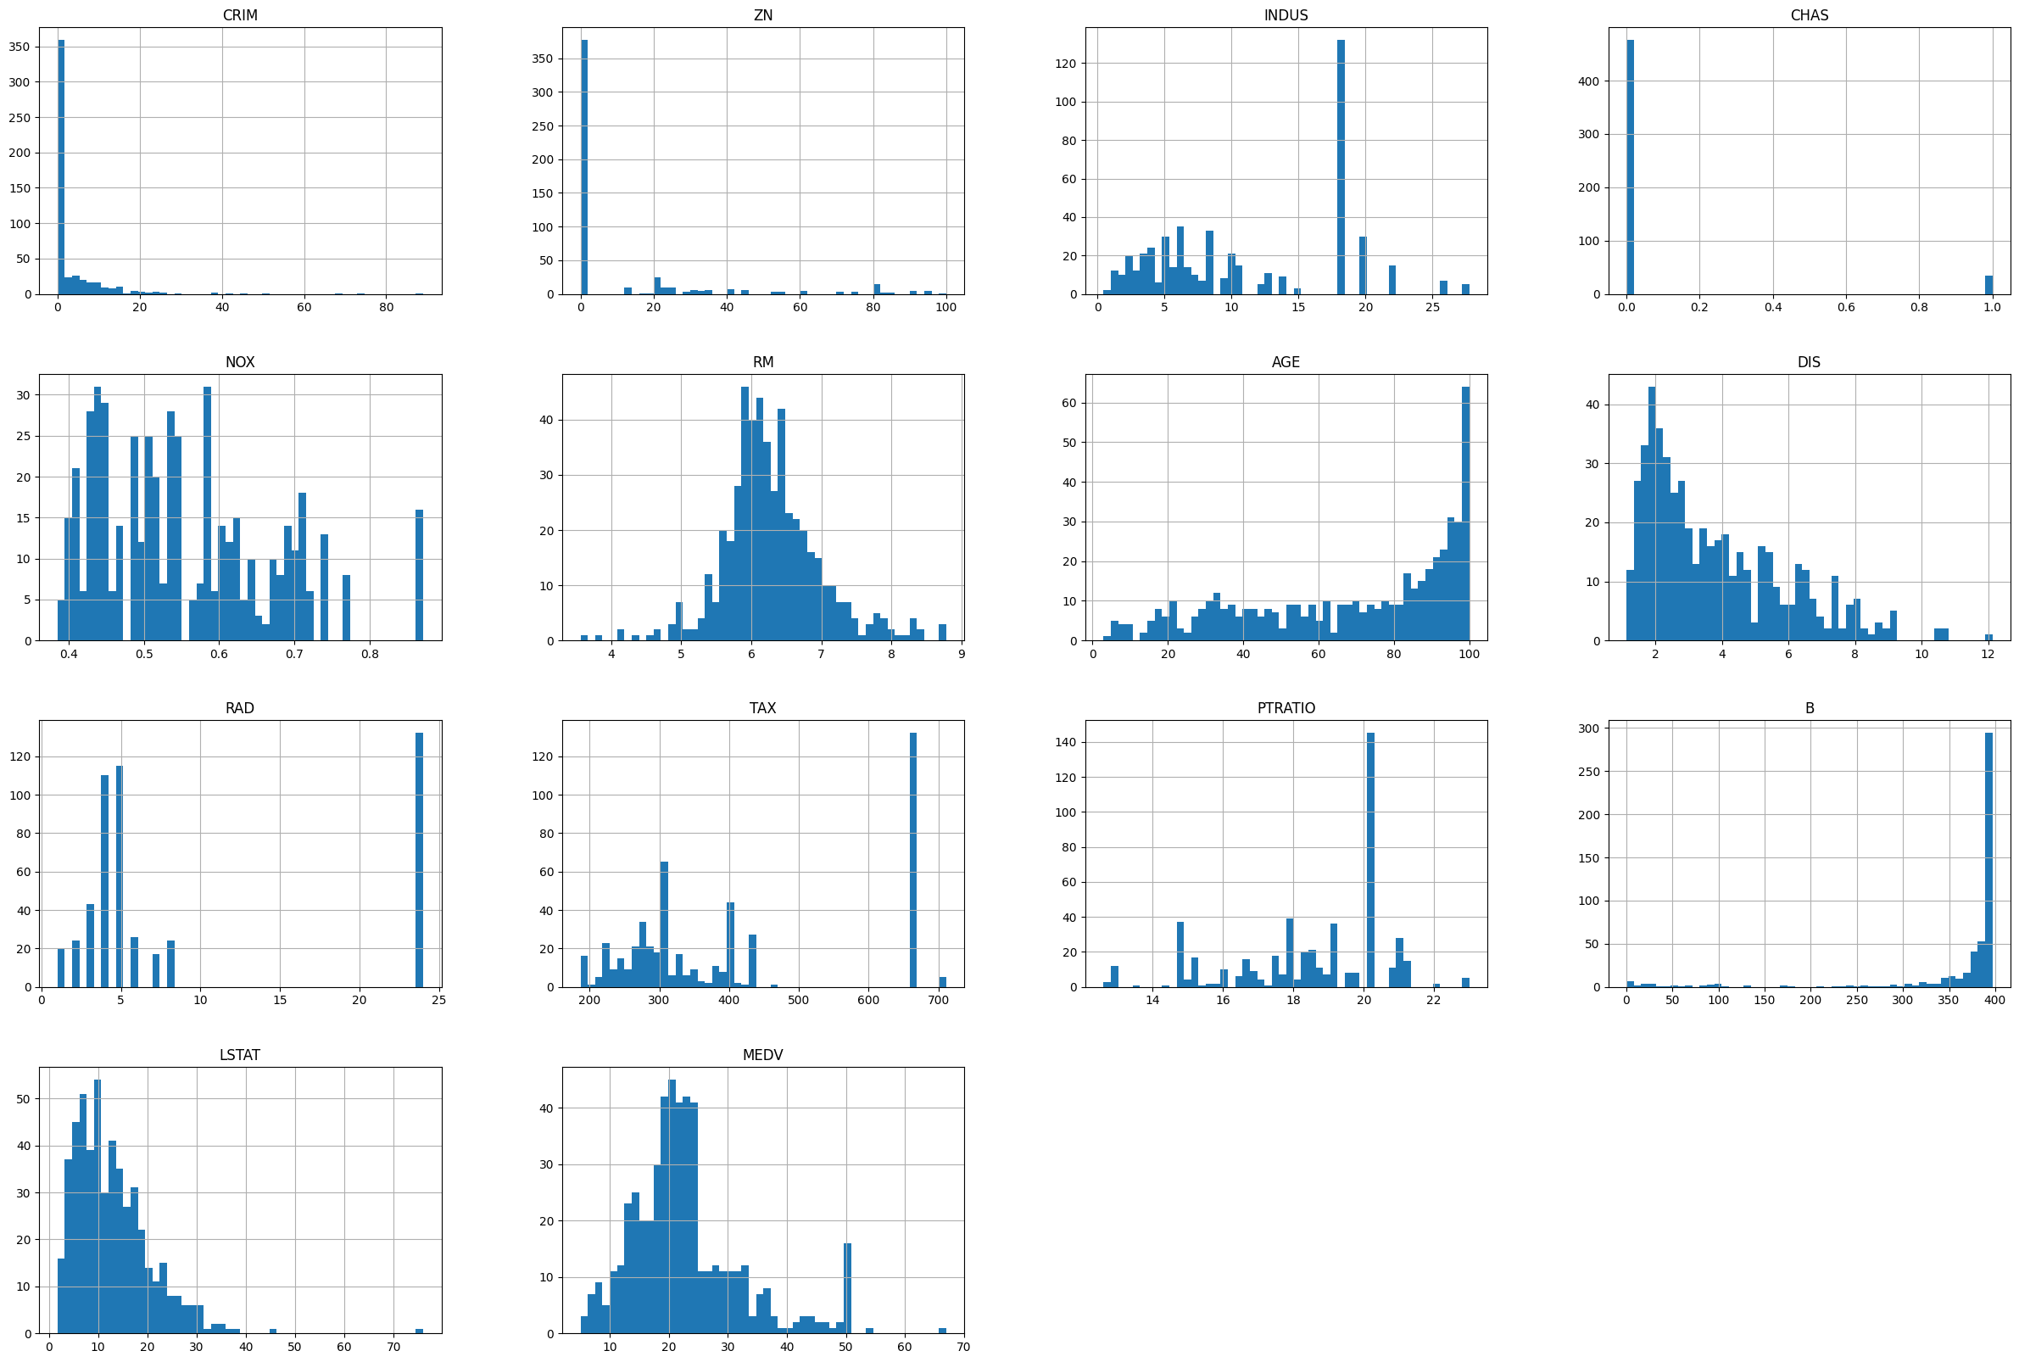
Exploratory Analysis

Slide 7
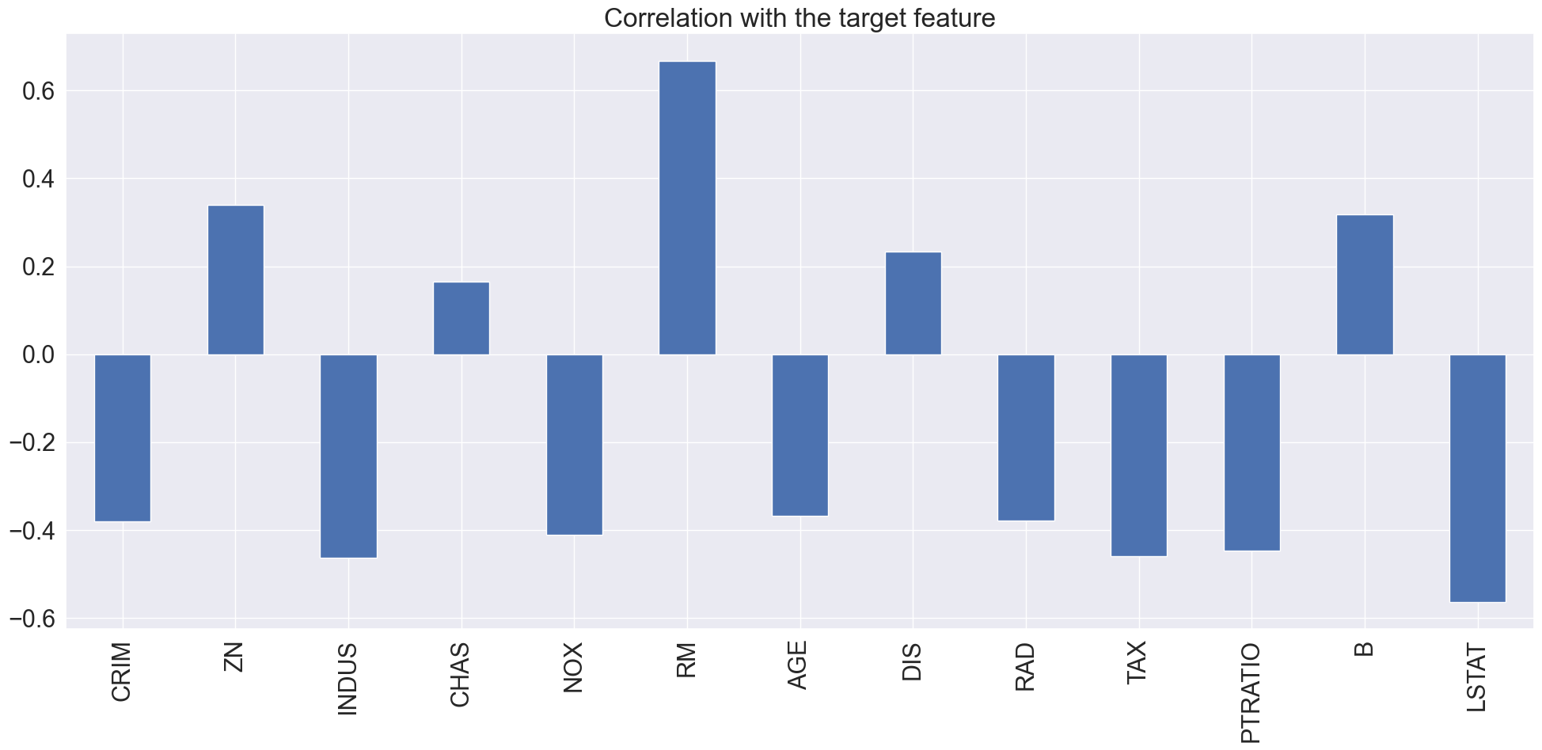
Correlation

Slide 8
Machine Learning Models
K – Nearest Neighbor
Linear Regression
Decision tree Regression
Random Forest Regression

Slide 9
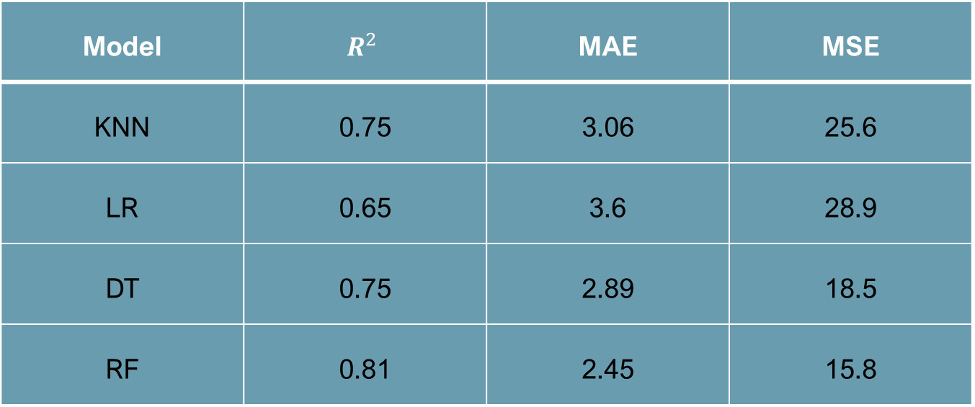
Evaluation Metrics
Model | $$R^{2}$$ | MAE | MSE
KNN | 0.75 | 3.06 | 25.6
LR | 0.65 | 3.6 | 28.9
DT | 0.75 | 2.89 | 18.5
RF | 0.81 | 2.45 | 15.8

Slide 11

Conclusion
MEDV is mostly affected by
RM and LSTAT
RF gave the best predictions

Slide 12
Self Learning
Understanding of Machine Learning Concepts:
developing a solid understanding of fundamental machine learning concepts, including supervised learning, regression analysis, and model evaluation.
Data Preprocessing Skills:
Preparing and cleaning real-world datasets , gaining experience in handling missing data, encoding categorical variables, and scaling numerical features.
Model Selection and Evaluation:
Working on a real estate prediction project likely involved experimenting with different machine learning models (e.g., linear regression, decision trees, random forest) and evaluating their performance using metrics such as mean squared error or R-squared.

Slide 13
References
Chatgpt.com
Github.com
Kaggle.com

Slide 14
Model Deployment Considerations:
Understanding the considerations and steps involved in deploying a machine learning model, even if it's not directly deployed, is a valuable skill. This includes considerations for scalability, interpretability, and maintenance.
Domain Knowledge in Real Estate:
You likely acquired domain-specific knowledge related to real estate, such as understanding the factors that influence property prices and the significance of different features in the context of the real estate market.
Critical Thinking and Problem-Solving:
Machine learning projects often involve addressing challenges and making decisions based on data. You may have honed your critical thinking and problem-solving skills throughout the project.
Project Management Skills:
Completing a machine learning project involves managing tasks, timelines, and resources. You may have developed project management skills in planning and executing different phases of the real estate prediction project.
Reflecting on these outcomes and considering how they contribute to your overall skill set will be valuable for your future endeavors in machine learning or related fields. The hands-on experience gained from working on a real-world project enhances your practical knowledge and prepares you for more complex challenges in the field.

